Slide 1


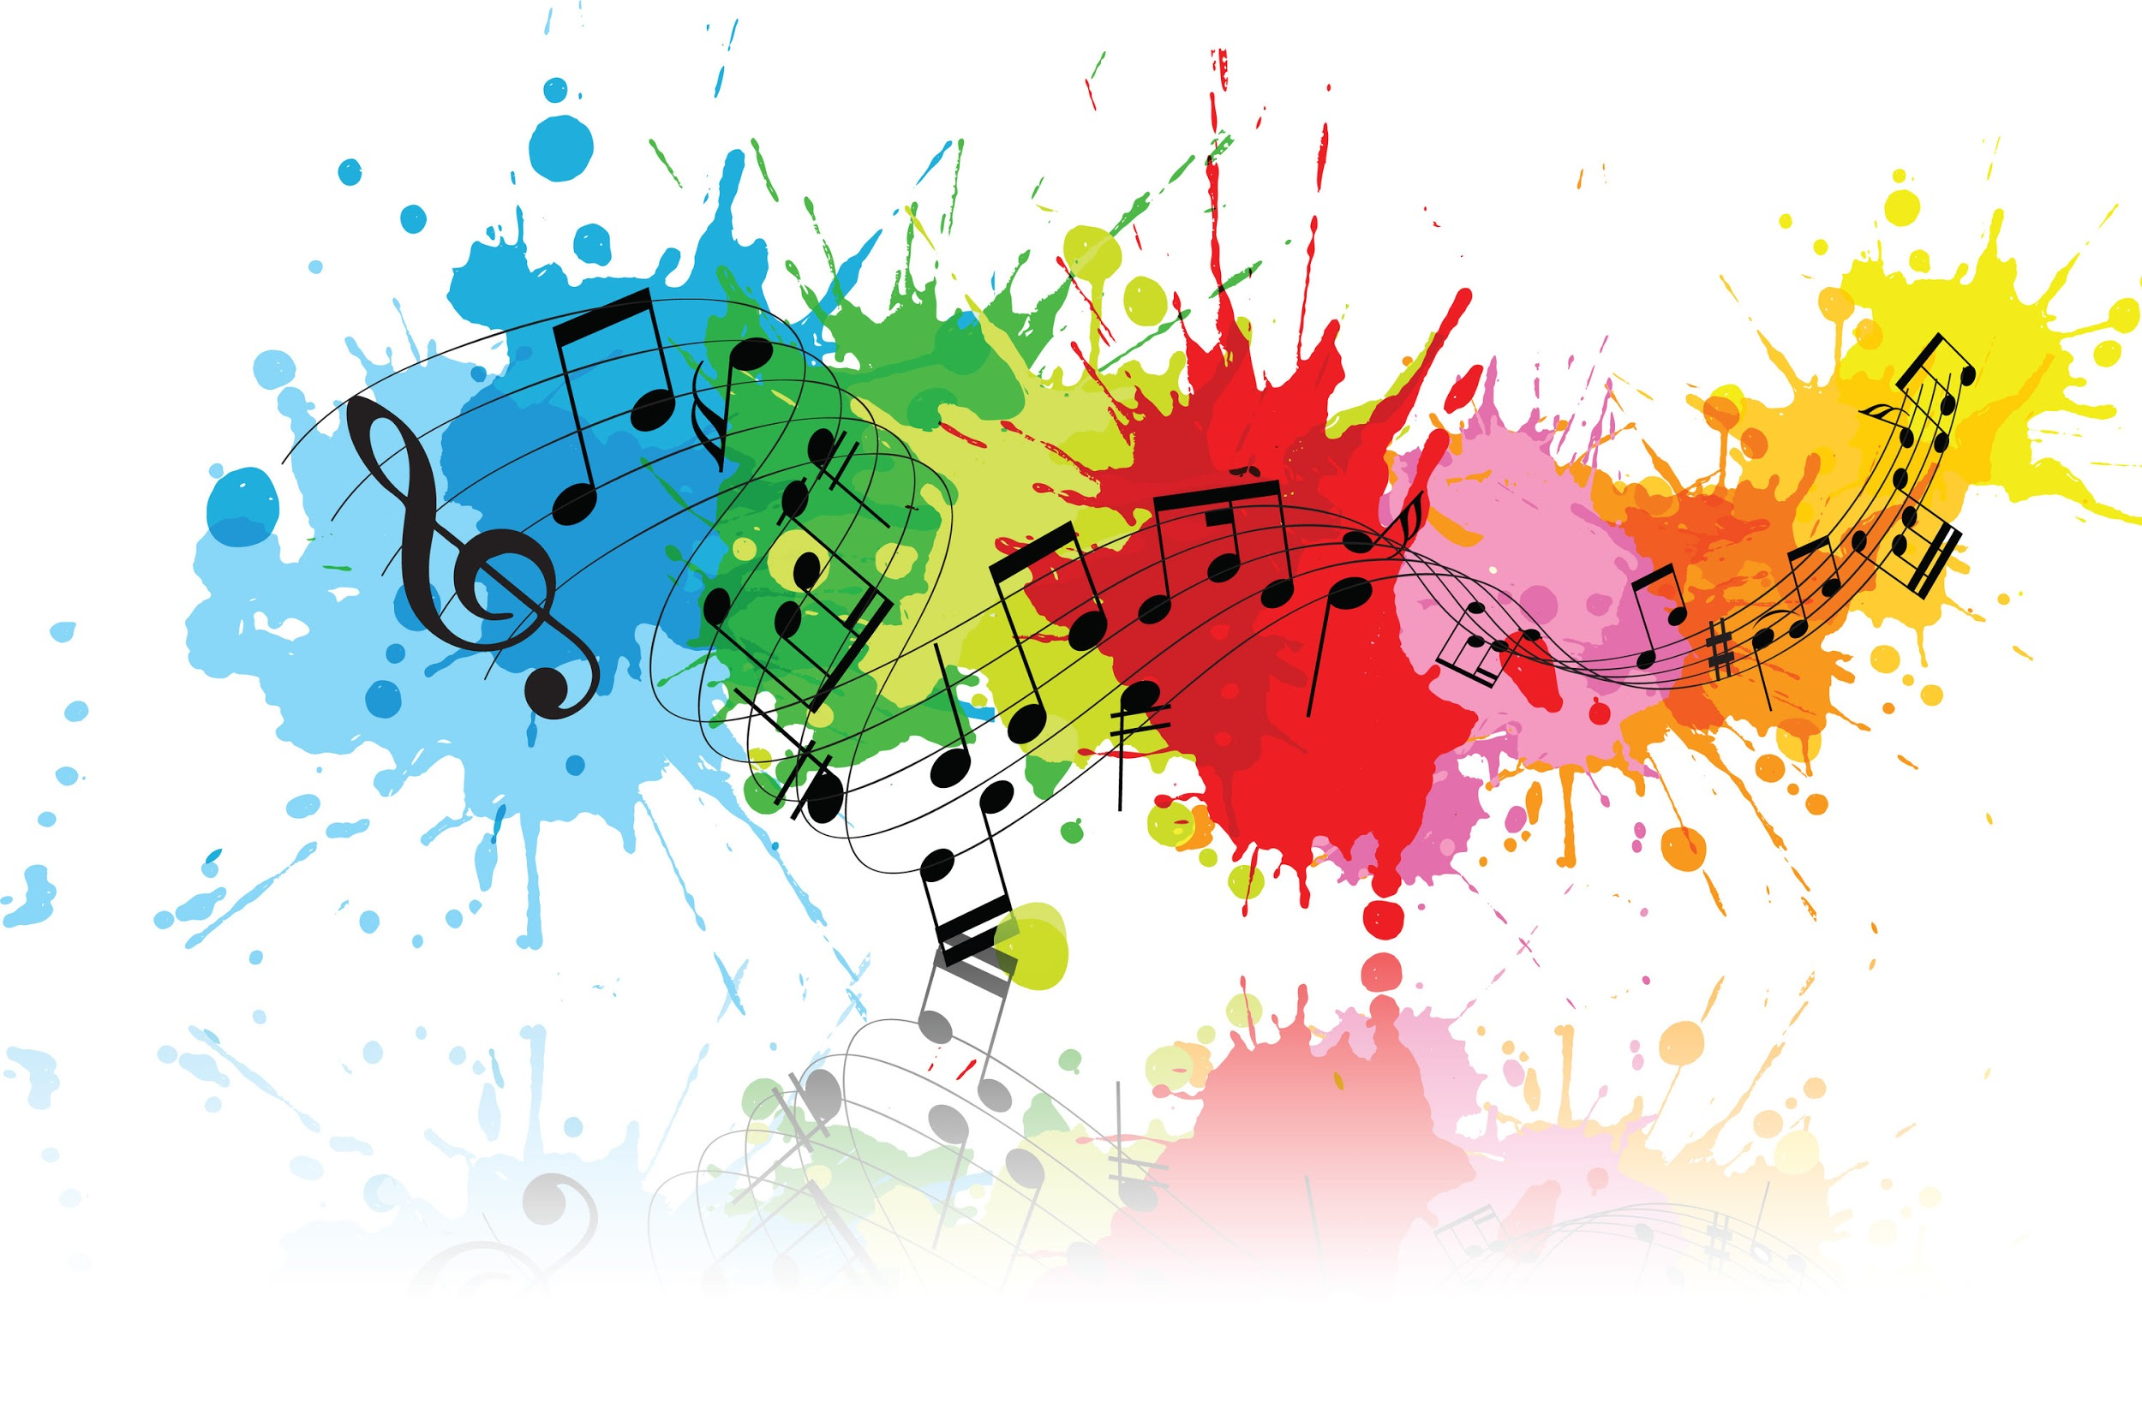

POP CULTURE RENEGADES
Public sentiment via popular culture

Slide 2
Building a Data Frame
Movies
Top grossing movie summaries
Books
NY Times Best Sellers
Plot database
Songs
Top 100 Billboard songs and lyrics
Issues we faced:
Inconsistent coding across books and movies databases.
Missing book plots.

Slide 3
Our Basic Emotions
Robert Plutchik's Basic Emotions
Synonyms and Stem (NLTK)
Hardcoded Synonyms

Slide 4
Natural Language Processing
Lyrics
Baby, I’m dancing in the dark with you between my arms. Barefoot on the grass, listening to our favorite song.
Tokens
[‘Baby’, ‘,’ ‘I’’, ‘’m’, ‘dancing’, ‘in’, ‘the’, ‘dark’, ‘with’, ‘you’, ‘between’, ‘my’, ‘arms’, ‘.’, ‘Barefoot’ , ‘on’, ‘the’, ‘grass’, ‘,’, ‘listening’, ‘to’, ‘our’, ‘favorite’, ‘song’, ‘.’]
Stopwords
[‘Baby’, ‘I’’, ‘’m’, ‘dancing’, ‘dark’, ‘arms’, ‘.’, ‘Barefoot’, ‘grass’, ‘,’, ‘listening’, ‘favorite’, ‘song’, ‘.’]

Slide 5
Model: Bag of Words
Steps
Build a dictionary that maps 8 basic emotions to derivatives, their synonyms, and stems.
For each song, movie, book, count the times these words appear, group them by basic emotion and year
Determine the frequency
Basic context control: VaderSentiment compound scores
Frequencies
Lyrics
Basic Emotions
Synonyms
Plots
Stems
Output
Data
Emotions

Slide 6
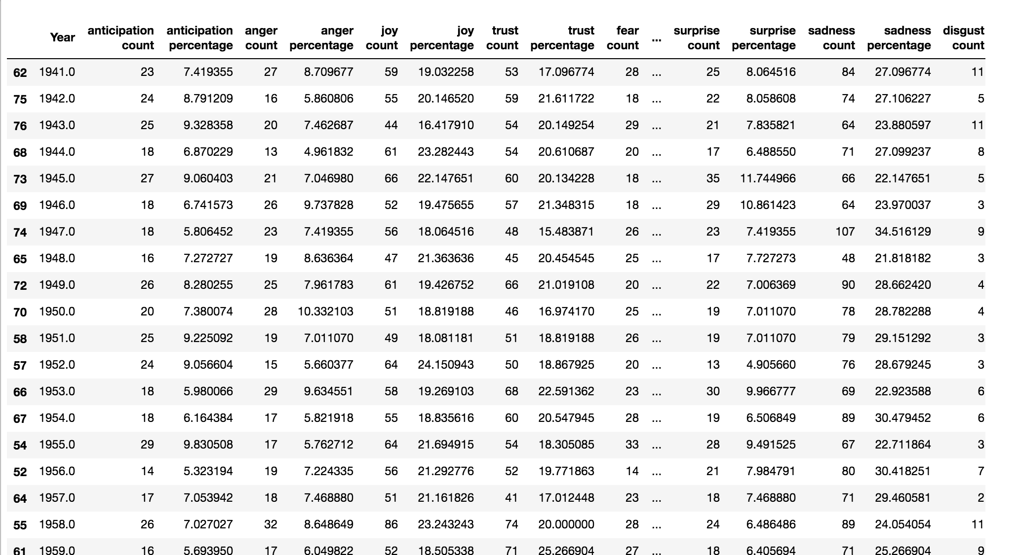
Bag of Words Output

Slide 7
Care to take a ride on our
time machine?

Slide 8


Alternative unsupervised models.
?
FUNDAMENTAL
PROBLEM
[[Love] [is] [all] [you] [need]]
[[I] [will] [never] [love] [again]]
Topic Extraction
Clustering
SciKit – Count Vectorizing & LatentDirichletAllocation
Takes list of all documents, generates a list of overarching common topics given the matrix of token counts.
-Expectation: Relation between the topics returned (specified 10, 50 words each)
-Obstacle: topics centered on genres, not feelings.
SciKit – TF-IDF matrix with tokens, 2grams and 3grams
-Expected – A clustering centered around common use of words and n-grams, somehow reflecting mood/sentiment.
-Obstacle – Matrix too disperse given amount of documents and lengthy/dispersed content -> Random clusters.
Notes:
In both, joy counter is increased by one even though both can be diametrically opposite.
Count vectorizing – matrix of token counts.
Term frequency – inverse document frequency: importance of a word in a document, in the context of the collection of documents. Weighting factors.

Slide 9

EXAMPLE TOPICS
Topic # 2 – vampires?
Topic #0 - relationships and love?
“dure vampir adult depict 1950 zombi tycoon dracula disastr defect laboratori reconcil mia outbreak kidnapp eldest culmin lola chester sub miracul antoin mild-mann o'hara 1976 syndic bori cover-up videotap conniv vaudevil thrive undermin starship usurp skipper creator hels bronson musket”
“know love im dont like do got no time see thi feel go say make want never babi come na one let have get oh caus way take cant not need thing wa tell right night heart ill look yeah”
Topic #1 - Europe in the XX century?
“novel german ii respons recent comedi expos explor seemingli version classic europ written rel sourc financi terrifi onto partner $ roman american film refer base identifi treatment horribl editor reach 1960 star empir shatter histor naiv circu havoc sword voyag”
Feeding our dictionary
for bag of words.

Slide 10
SONGS
BOOKS
MOVIES
ALL
TOTAL
DOCUMENTS
4,913
382
7,686
12,981
CLEAN
TOTAL
TOKENS
PER ITEM (MEAN)
185
394
38
104.3
TOTAL
SENTIMENT-TOKENS
PER ITEM (MEAN)
29
27
2.5
13.2
% OF FEELINGS
IN TOTAL TOKENS
16% *
7%
7%
13%
DOCUMENTS WITH
NO FEELINGS
-
5
1,213
1,207

Slide 11
Learnings and caveats
Feelings are not core to the documents analyzed.
Factors in common between texts seem to be orthogonal to feelings.
13% on average of the total of words used by text.
Difference between types of inputs:
Books and movies – Objective descriptions, not a lot of reference to feelings.
Songs – figurative language.
Examples: Blues, warmth, crying.
Persistent problem: beyond bag of words.

Slide 12
QUESTIONS?

